Slide 1
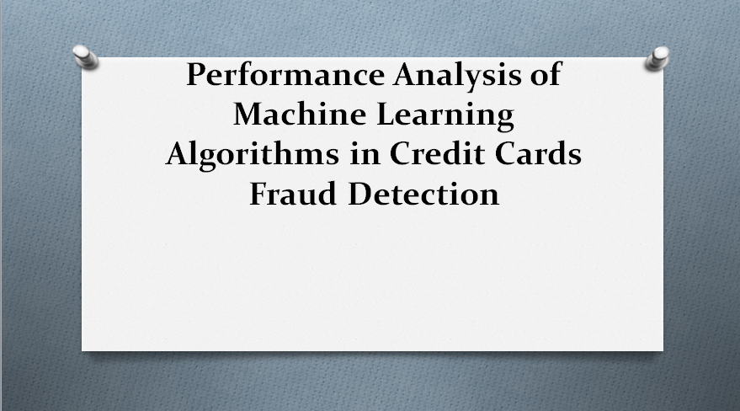

Slide 2
Introduction
Credit cards are used by customers to purchase goods and services within their credit limit or withdraw cash in advance. However, they are easy targets for fraudsters, as they can withdraw large amounts without the owner's knowledge. In 2017, there were 1,579 data breaches and nearly 179 million records, with credit card frauds being the most common. As banks transition to EMV cards, some on-card payments are safer, but card-not-present frauds remain at higher rates. Criminals have shifted their focus to activities related to card-not-present transactions. Despite advancements, there are still chances for thieves to misuse credit cards.

Slide 3
Project Objective
objective of this project is to develop and evaluate machine learning models capable of accurately identifying fraudulent
credit card transactions in real-time. This will be achieved by training models on historical transaction data and optimizing them to minimize both false positives and false negatives, thereby reducing financial losses and protecting customers.

Slide 4
Problem Statement
Credit card fraud results in significant financial losses for both consumers and financial institutions. This project aims to develop and evaluate machine learning models to accurately and efficiently detect fraudulent credit card transactions in real-time, minimizing these losses.

Slide 5
Existing System
Existing credit card fraud detection systems often rely on rule-based systems or traditional machine learning algorithms like logistic regression or decision trees. These systems may struggle with evolving fraud patterns and complex data relationships, leading to lower detection rates and higher false positives.

Slide 6
Proposed Work
This section describes the proposed ML framework in detail. The framework is designed such that, given a set of bank accounts and transactions, the framework will return a list containing potential groups of money laundering accounts. The framework starts by reviewing the input and searching for matching transactions. Matching transactions are financial transactions that have common attributes such as similarity in deposit and withdrawal amounts. Next the framework generates a network representation of all matching transactions. It then uses network-based algorithms to filter out unnecessary accounts and transactions. The framework then applies a clustering method to find suspicious ML communities within the network.

Slide 7
Algorithm
SVM(Support Vector Machine):
Support Vector Machine or SVM is one of the most popular Supervised Learning algorithms, which is used for Classification as well as Regression problems.
However, primarily, it is used for Classification problems in Machine Learning.
The goal of the SVM algorithm is to create the best line or decision boundary that can segregate n-dimensional space into classes so that we can easily put the new data point in the correct category in the future. This best decision boundary is called a hyperplane.
SVM chooses the extreme points/vectors that help in creating the hyperplane.
These extreme cases are called as support vectors, and hence algorithm is termed as Support Vector Machine. Consider the below diagram in which there are two different categories that are classified using a decision boundary or hyperplane.

Slide 8
Algorithm
Haarcascade Algorithm:
Haar cascade is an algorithm that can detect objects in images, irrespective of their scale in image and location.
This algorithm is not so complex and can run in real-time. We can train a haar-cascade detector to detect various objects like cars, bikes, buildings, fruits, etc.
Haar cascade uses the cascading window, and it tries to compute features in every window and classify whether it could be an object.

Slide 9
Methodology
Machine Learning:
Machine learning (ML) is a type of artificial intelligence (AI) that allows software applications to become more accurate at predicting outcomes without being explicitly programmed to do so. Machine learning algorithms use historical data as input to predict new output values.
Machine learning (ML) is the study of computer algorithms that can improve automatically through experience and by the use of data. It is seen as a part of artificial intelligence. Machine learning algorithms build a model based on sample data, known as training data, in order to make predictions or decisions without being explicitly programmed to do so.
Machine learning algorithms are used in a wide variety of applications, such as in medicine, email filtering, speech recognition, and computer vision, where it is difficult or unfeasible to develop conventional algorithms to perform the needed tasks.
A subset of machine learning is closely related to computational statistics, which focuses on making predictions using computers; but not all machine learning is statistical learning. The study of mathematical optimization delivers methods, theory and application domains to the field of machine learning. Data mining is a related

Slide 10
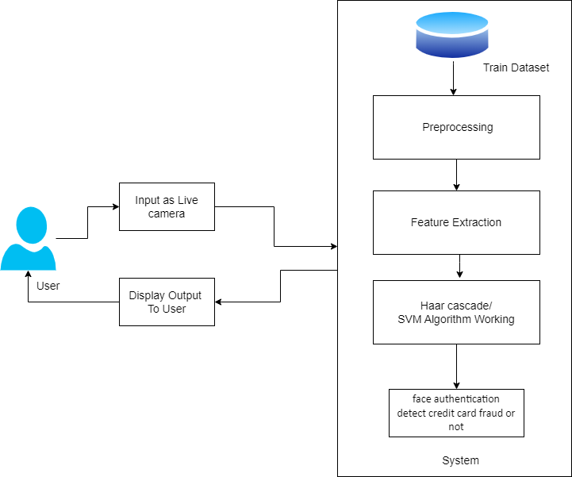
System Architecture

Slide 11
Literature Survey
Literature Survey
Sr. No | Title | Authors/Year | Advantages | Description
1 | Credit Card Fraud Detection using Machine Learning Algorithms | friendly targets. E-commerce and many other online site (2019). | Machine learning models can analyze transactions in real-time, enabling immediate detection and prevention of fraudulent activities. | The main aim of the paper is to design and develop a novel fraud detection method for Streaming Transaction Data, with an objective, to analyse the past transaction details of the customers and extract the behavioural patterns.
2 | OptDevNet: A Optimized Deep Event-Based Network Framework for Credit Card Fraud Detection | MUHAMMAD ADIL 1, (Senior Member, IEEE), ZHANG YINJUN2, (Member, IEEE), MONA M. JAMJOOM 3, (Member, IEEE), AND ZAHID ULLAH 4, (Member, IEEE)(2024) | Credit card fraud datasets are often imbalanced, with far fewer fraudulent transactions than legitimate ones. OptDevNet may incorporate techniques to address this imbalance, improving the model's ability to detect rare fraudulent cases. | These limitations motivated us to comprehensively assess the existing machine learning classifiers and propose an Optimized Deep Event-based Network (OptDevNet) framework capable of addressing these challenges.

Slide 12
Literature Survey
Literature Survey
Sr. No | Title | Authors/Year | Advantages | Description
3 | Robust Credit Card Fraud Detection Based on Efficient Kolmogorov-Arnold Network Models | THI-THU-HUONG LE 1,2, YEONJEONG HWANG 3, HYOEUN KANG 4, AND HOWON KIM 3, (Member, IEEE)(2024) | KANs are known for their ability to approximate complex functions with high accuracy. This can be particularly beneficial in fraud detection, where the patterns of fraudulent transactions can be intricate and difficult to identify. | This paper explores the application of KAN in the context of credit card fraud detection, motivated by the need for more effective and interpretable solutions.
4 | Credit Card Fraud Detection Using State-of-the-Art Machine Learning and Deep Learning Algorithms | FAWAZ KHALED ALARFAJ 1, IQRA MALIK2, HIKMAT ULLAH KHAN 3, NAIF ALMUSALLAM1, MUHAMMAD RAMZAN 2, AND MUZAMIL AHMED 3.(2024) | Many of these models are designed for speed. They can analyze transactions as they happen, enabling instant blocking of suspicious activity. This is crucial for minimizing losses. | The main focus has been to apply the recent development of deep learning algorithms for this purpose. Comparative analysis of both machine learning and deep learning algorithms was performed to nd efcient outcomes.

Slide 13
Literature Survey
Literature Survey
Sr. No | Title | Authors/Year | Advantages | Description
5 | Ensemble Synthesized Minority Oversampling-Based Generative Adversarial Networks and Random Forest Algorithm for Credit Card Fraud Detection | FUAD A. GHALEB 1, FAISAL SAEED 2, (Member, IEEE), MOHAMMED AL-SAREM 3, SULTAN NOMAN QASEM 4, (Senior Member, IEEE), AND TAWFIK AL-HADHRAMI | Combining multiple models (in this case, Random Forest with potentially other models in the ensemble) leverages the strengths of each. This often leads to higher accuracy and robustness than using a single model. | credit card fraud detection model (CCFDM) is proposed based on ensemble learning and a generative adversarial network (GAN) assisted by Ensemble Synthesized Minority Oversampling techniques (ESMOTE-GAN).
6 | A Credit Card Fraud Detection Method Based on Mahalanobis Distance Hybrid Sampling and Random Forest Algorithm | ZHICHAO XIE AND XUAN HUANG(2024). | Random Forest provides insights into which features are most important in detecting fraud, which can be valuable for understanding fraud patterns and improving the detection system. | This project addresses the problems of existing credit card fraud detection methods and, based on the domain knowledge of credit card fraud and machine learning theory, proposes a method based on Mahalanobis distance SMOTE-ENN hybrid sampling and Random Forest for credit card fraud detection.

Slide 14
Literature Survey
Literature Survey
Sr. No | Title | Authors/Year | Advantages | Description
7 | Credit Card Fraud Detection Using AdaBoost and Majority Voting | KULDEEP RANDHAWA 1, CHU KIONG LOO (Senior Member, IEEE), MANJEEVAN SEERA | AdaBoost can provide insights into which features are most important for detecting fraud. This can be valuable for understanding fraud patterns and potentially for feature selection or engineering | In this paper, machine learning algorithms are used to detect credit card fraud. Standard models are rst used. Then, hybrid methods which use AdaBoost and majority voting methods are applied.
8 | Advancing Model Performance With ADASYN and Recurrent Feature Elimination and Cross-Validation in Machine Learning-Assisted Credit Card Fraud Detection: A Comparative Analysis | EMMANUEL ILEBERI AND YANXIA SUN , (Senior Member, IEEE) | Different banks might have different customer demographics, transaction types, or even data collection methods. This leads to variations in the features available or their distributions. | we use the Adaptive Synthetic Minority Oversampling Technique to balance an imbalanced dataset; then we combine that with the Recursive Feature Elimination with the validation technique to enhance the performance of credit card fraud detection systems.

Slide 15
Literature Survey
Literature Survey
Sr. No | Title | Authors/Year | Advantages | Description
9 | FedFusion: Adaptive Model Fusion for Addressing Feature Discrepancies in Federated Credit Card Fraud Detection | NAHID FERDOUS AURNA 1, MD DELWAR HOSSAIN 1, (Member, IEEE), LATIFUR KHAN 2, (Fellow, IEEE), YUZO TAENAKA1, (Member, IEEE), AND YOUKI KADOBAYASHI1, (Member, IEEE) | Different banks might have different customer demographics, transaction types, or even data collection methods. This leads to variations in the features available or their distributions. | the practical implementation of FL is challenged by data heterogeneity among institutions, complicating model convergence.
10 | Deep Learning for Credit Card Fraud Detection: A Review of Algorithms, Challenges, and Solutions | IBOMOIYE DOMOR MIENYE , (Member, IEEE), AND NOBERT JERE | Credit card transaction data is often massive. Deep learning models are designed to handle such large datasets efficiently, making them suitable for real-world applications. | This study reviews the recent DL-based literature and presents a concise description and performance comparison of the widely used DL techniques, including convolutional neural network (CNN)

Slide 16
Scope of Project
The main scope of this project is to detect the online fraud and transaction fraud.

Slide 17
Advantages/Disadvantages
Advantages:
User friendly system.
We can identify and group potential Credit card accounts.
Disadvantages:
If the training not get successful or get interrupt because of any reason then system can not work proper.

Slide 18
Software Requirements
IDE : Spyder
Coding Language : Python Version 3.8
Operating System : Windows 10
Frontend :tkinter
Backend :Python

Slide 19
Hardware Requirements
Processor : Pentium-IV
Speed : 1.1 GHz
RAM :512 MB(min)
Hard Disk : 40 GB
Key Board : Standard Windows Keyboard
Mouse : Two or Three Button Mouse
Monitor : LCD/LED

Slide 20
Application
Helps To banking system.
All User

Slide 21
Conclusion
The proposed ML framework aims to find potential Credit card fraud groups among a large number of financial transactions. In order to improve the efficiency of the framework, case reduction methods such as matching transaction detection and balance score filter are used to narrow down the list of potential ML accounts. Next by taking advantage of structural similarity, we can identify and group potential Credit card accounts. Our preliminary experimental results show a high degree of accuracy in detection of ML accounts.

Slide 22
Future Scope
In future we can implement this system on android application.

Slide 23
References
[Jiang, Changjun et al. “Credit Card Fraud Detection: A Novel Approach Using Aggregation Strategy and Feedback Mechanism.” IEEE Internet of Things Journal 5 (2018): 3637-3647.
R. B. Sulaiman, V. Schetinin, and P. Sant, ‘‘Review of machine learning
approach on credit card fraud detection,’’ Hum.-Centric Intell. Syst., vol. 2, nos. 1–2, pp. 55–68, 2022[3] A. Charleonnan, "Credit card fraud detection using RUS and MRN algorithms," 2016 Management and Innovation Technology International Conference (MITicon), Bang-San, 2016, pp. MIT-73MIT-76. doi: 10.1109/MITICON.2016.8025244
Nilson Report. Accessed: Jun. 6, 2024. [Online]. Available: https:// nilsonreport.com/articles/card-fraud-losses-worldwide-2/
Y. Fang, Y. Zhang, and C. Huang, ‘‘Credit card fraud detection based on
machine learning,’’ Comput., Mater. Continua, vol. 61, no. 1, pp. 185–195, 2019.

Slide 24
References
(2023). China Union Pay, Payment, and Clearing Association of
China. Blue Book on the Development of China’s Bank Card Industry.
Accessed: Sep. 28, 2023. [Online]. Available: https://finance.china.
com.cn//money/bank/hydt/20230928/6037001.shtml
Y. Sahin, S. Bulkan, and E. Duman, ``A cost-sensitive decision tree
approach for fraud detection,'' Expert Syst. Appl., vol. 40, no. 15,
pp. 59165923, 2013.
[8] V. V. Kumar, ‘‘Credit card fraud detection using machine learning,’’
Comput. Intell. Mach. Learn., vol. 4, no. 1, pp. 71–79, Apr. 2023
B. Lebichot, G. M. Paldino, W. Siblini, L. He-Guelton, F. Oblé, and
G. Bontempi, ‘‘Incremental learning strategies for credit cards fraud
detection,’’ Int. J. Data Sci. Anal., vol. 12, no. 2, pp. 165–174, Aug. 2021.
D. Chicco and G. Jurman, ‘‘The advantages of the Matthews correlation
coefficient (MCC) over F1 score and accuracy in binary classification
evaluation,’’ BMC Genomics, vol. 21, no. 1, pp. 1–13, Dec. 2020.

